Slide 1
Iot based icu monitoring system
Section ECE-C Batch no.12
Name of the Student Register number
B.SAI NIKHIL 20A95A0413
V.BHAGYA SRI 19A91A04J0
S.SAI KUMAR 19A91A04I3
G.DIVAKAR 19A91A04F0

Slide 2

Aditya Engineering College (A)
Contents:
Abstract
Significance/Introduction
Methodology/Principle of Operation
Block Diagram/Algorithm.
Applications.
Conclusion.
References.

Slide 3

Aditya Engineering College (A)
Abstract
Monitoring various parameters of the patient using internet of things.
The real-time parameters of patient’s health are sent to cloud using Internet connectivity.
These parameters are sent to a remote Internet location so that user can view these details from anywhere in the world.
The reason behind this is that the data needs to be monitored by visiting a website or URL.
There are various cloud service providers which can be used to view this data over Internet.

Slide 4
Aditya Engineering College (A)
With the development of world, Health monitoring system is used every field such as hospital, home care unit, sports.
This health monitoring system use for chronicle diseases patients who have daily check-up.
Normally it is difficult to keep track on abnormalities in heartbeat count for patient itself manually.
The average heartbeat per minute for 25- year old ranges between 140-170 bpm while for a 60-year old it is around between 115-140 bpm and body temperature is 37degree Celsius or 98.6 Fahrenheit.
Patients are not well versed with manual treatment which doctors normally use for tracking the count of heartbeat. There are various instruments available in market to keep track on internal body changes. But there are many limits in maintenance part due to their heavy cost, size of instruments and mobility of patients.
Introduction

Slide 5
Aditya Engineering College (A)
Different biomedical sensors like temperature sensor, heart rate sensor, blood pressure sensor are used for monitoring the health condition which is integrated on single system on-chip.
If any varied change takes place it is notified. This notification would help to take an appropriate action at an instance of a time. This would save patients from the future health problem. This would also help patient's concern doctor to take an appropriate action at proper time.
Introduction

Slide 6
Methodology
Aditya Engineering College (A)
Intensive Care Unit or ICU is where the patients who are critically ill are admitted for treatment.
For such critical conditions the Doctors need to have an all-time update patient’s health related parameters like their blood pressure, heart pulse and temperature.
To do manually, this is too tedious a task and also for multiple patients it becomes close to impossible.
For this type of situations this IOT based system can bring about an automation that can keep the Doctors updated all time over internet.
IOT Based ICU Patient Monitoring System is a ARDUINO UNO based system which collects patient’s information with the help of few sensors.
It uses Wifi module to communicate this information to the internet. There is this Blood pressure and heart beat monitor module electrically connected to the system and physically to be worn by the user.

Slide 7
Aditya Engineering College (A)
Methodology
On the press of button, the sensor senses the blood pressure in systolic and diastolic along with the heart beat and sends it to the central controller.
The Temperature sensor senses the temperature of its ambience, so when this sensor is in close proximity of the user it reports the users’ body temperature.
Thus, the doctor can get access to these vital parameters pertaining to the patients’ health over the IOT Gecko web interface from anywhere over the world.
In this way IOT Based ICU Patient Monitoring System is an enhanced system that helps in monitoring ICU Patients without any manual intervention.

Slide 8
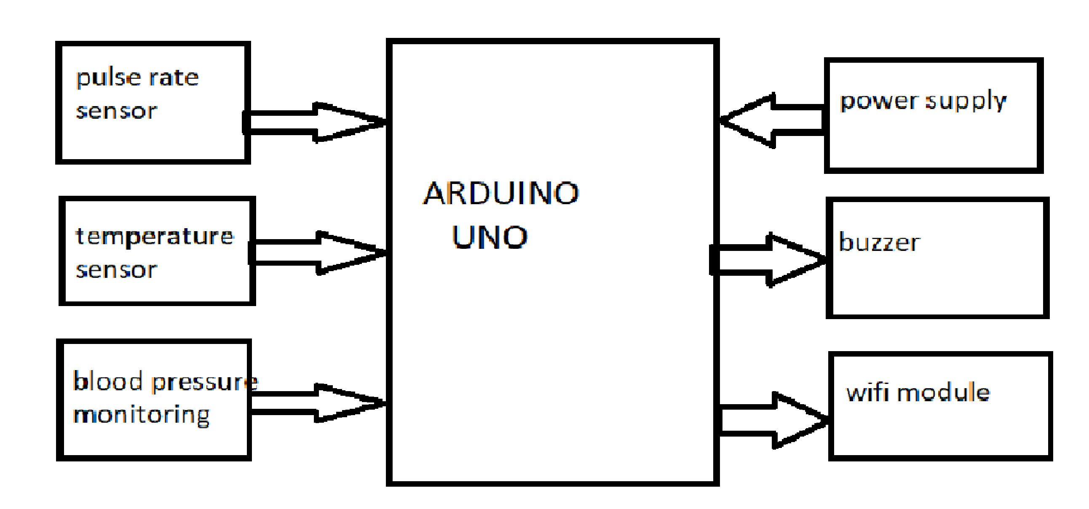
Block Diagram/Algorithm.
Aditya Engineering College (A)

Slide 9
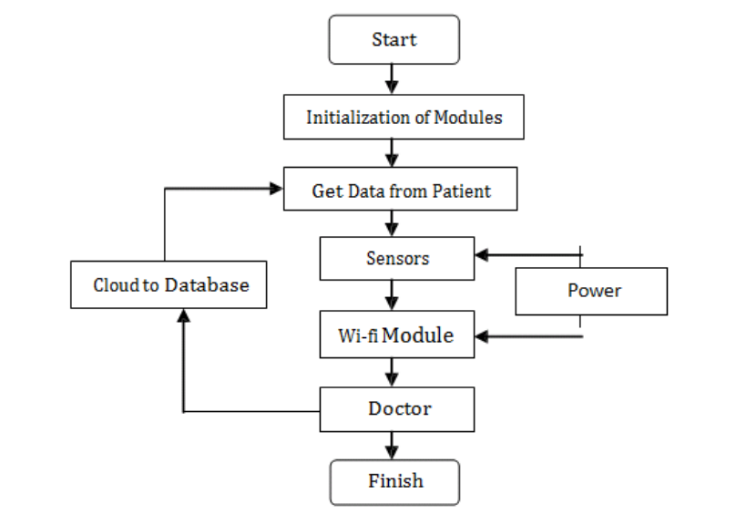
Flow chart.
Aditya Engineering College (A)

Slide 10
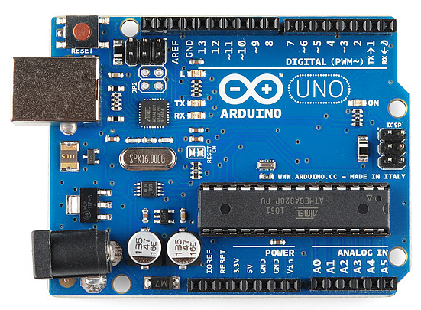
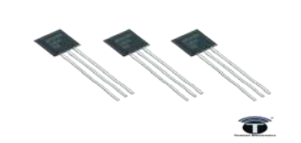
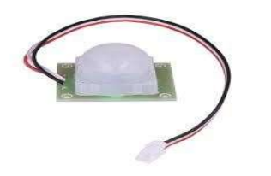
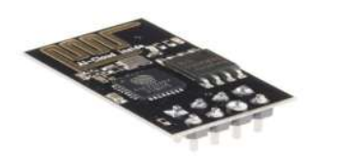
Flow chart.
Aditya Engineering College (A)
Arduino uno
LM35 temperature sensor
Pulse rate sensor
WIFI module

Slide 11
Applications
Aditya Engineering College (A)
As the doctors cant monitor continuously the patients condition for every minute to minute.
We can use this application to measure BP,pulse rate,temperature without the doctors interference at any time

Slide 12
Conclusion
Aditya Engineering College (A)
For such critical conditions the doctors need to have an all time update patient’s health related parameters like their blood pressure, heart pulse and temperature.
In this way IOT Based ICU Patient Monitoring System that helps in monitoring ICU Patients without any manual intervention. The output from sensor and amplifier circuit was connected to the arduino .
The observed output signal was periodic ac signal with amplitude varying from peak to peak according to person. A sinusoidal signal and the output from sensor were fed to arduino and the counted pulse rate was successfully sent via Wi-Fi module.

Slide 13
References
Aditya Engineering College (A)
[1] Mr Alam “IOT Based Patient Health Monitoring Using ESP8266 & Arduino”[June 11,2019]
[2] Engr Fadhad”IOT Based Patient Monitoring System Using ESP8266,Arduino &Android Bluetooth App”[August 31,2019]
[3] https://www.engineersgarage.com/what-is-gsm-gprs- module[0ct [11 ,2017]
[4]https://tkkrlab.nl/wiki/Arduino_37_sensors [Oct 20, 2017]
[5] https://www. deepdyve.com/lp/institute-of-electrical- and-electronics-engineers/ubiquitous-data-accessing- methodin-iot-based-information-system-for- YCZzyY5W9g [Sept 6, 2017] [6]https://scholar.google.com/citations?user=Y4opLB8A AAAJ&hl=en [Sept. 7, 2017]Cloud to Database Wi-fi Module Doctor Finish

Slide 14
References
Aditya Engineering College (A)

